Slide 1
Software Measurement Metrics and Correlation analysis
Team N
Samir Anghan: 40040308
Neha Sarang Dighe: 40105186
Aamrean Singh Kaler:40080820
Aayush Lamichhane : 40091493
Shashank Rao: 40104247

Slide 2
Outline
Metrics
Project Introduction
Data Collection
Related work
Analysis of Correlation of Metrics
Conclusion

Slide 3
Metrics
Metric 1&2: Statement coverage and branch coverage
Metric 3: Mutation Score
Metric 4: McCabe metric (Cyclomatic complexity)
Metric 5: Maintainability index
Metric 6: Backlog Management Index

Slide 4
Metric 5: Maintainability index
Combination of several metrics
Cyclomatic Complexity
Average Lines of Code
Halstead Volume
MI = 171 - 5.2 * ln(V) - 0.23 * (G) - 16.2 * ln (LOC)
Where, LOC = count of source Lines of Code (SLOC)
V = Halstead Volume
G = Cyclomatic Complexity
The maintainability index is a value between 1 and 100
Represents the relative ease of maintaining the code
A high value means better maintainability

Slide 5
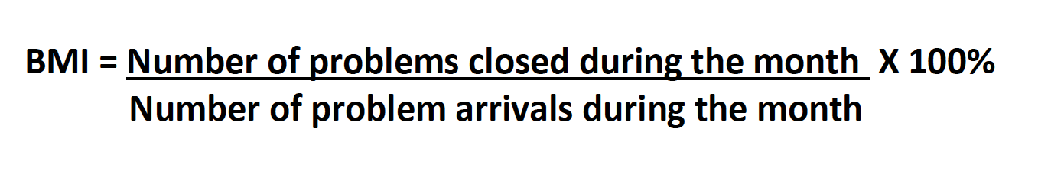
Metric 6: Backlog Management Index
A simple count of reported problems that remain at the end of each month or each week
Manages the backlog of open, unresolved, problems
Uses Fix Backlog
Related to both:
the rate of defect arrivals
the rate at which fixes for reported problems become available

Slide 6
LOC, Statement coverage, Branch coverage, Mutation Score
PROJECT | LOC | Total Statement Coverage | Total Branch Coverage | Total Mutation Coverage | Mutation Score %
Apache Commons Configuration | 88.5 K | 93% | 84% | 4276/5514 | 78%
Apache Commons Collections | 132 K | 89% | 78% | 3260/6518 | 50%
Apache Common Codec | 162.3 K | 97% | 88% | 2798/3205 | 87%
Apache Commons Math | 187.8 K | 92% | 83% | WIP | WIP
RxJava | 288.4 K | 93% | 89% | WIP | WIP

Slide 7
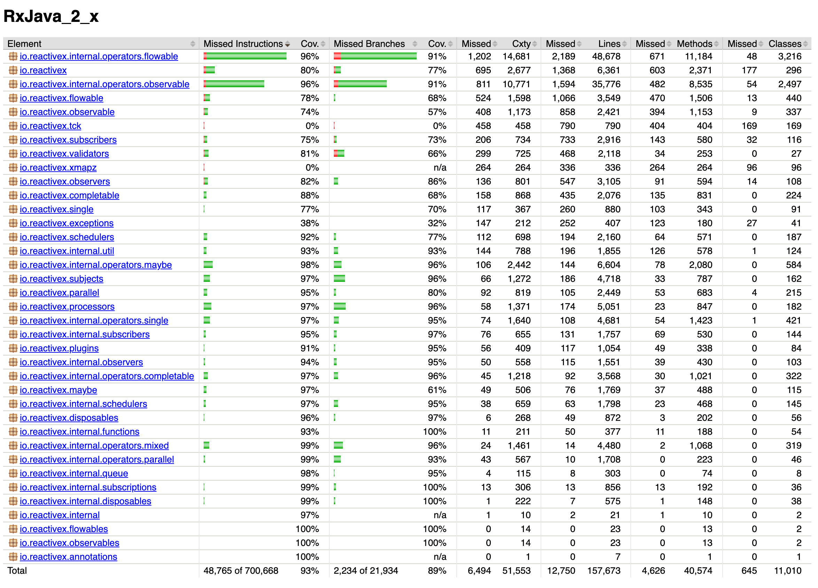
Data Collections – Metric 1 & 2 Tool used: JaCoCo

Slide 8
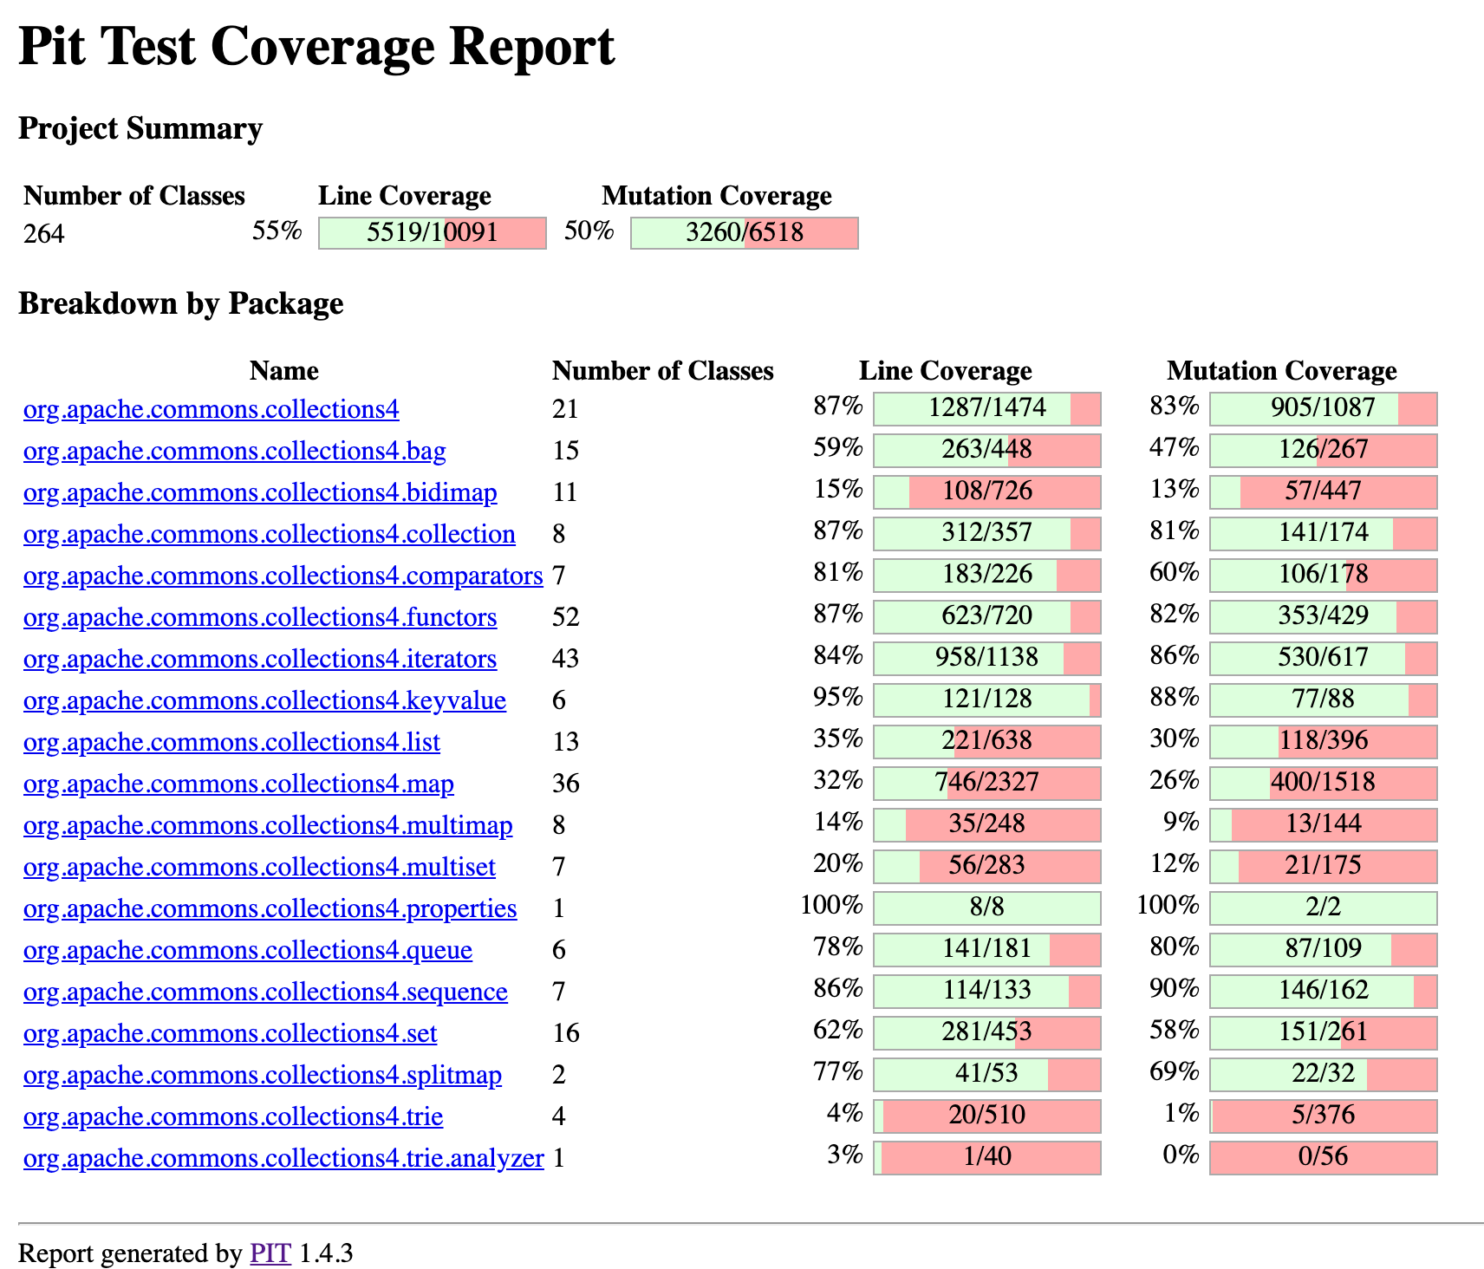
Data Collections – Metric 3 Tool used: PITest
Project: Apache Common Collections

Slide 9
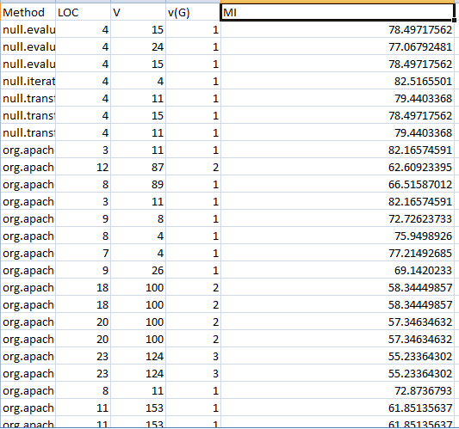
Project: Apache Common Collections : Computed based on Cyclomatic complexity v(G) and Halstead Complexity(V) MI=((171-(5.2*LN(C2))-(0.23*D2)-(16.2*LN(B2)))/171)*100
Data Collections – Metric 4 & 5 Tool used: Metrics Reloaded

Slide 10
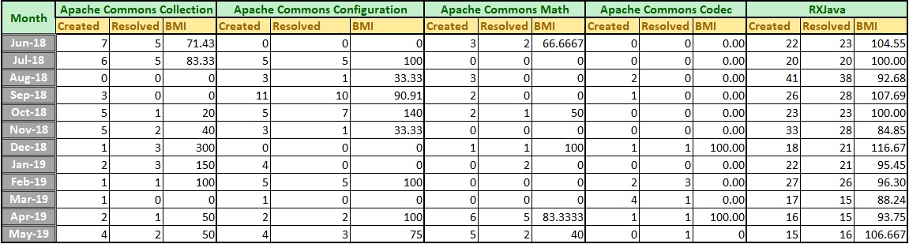
Issue tracking system- Apache JIRA for Apache projects, Github issue tracker for other projects.
Data Collections – Metric 6

Slide 11
Summary: LOC, Statement Coverage, Branch Coverage, mutation score, Cyclomatic Complexity, BMI, Maintainability index
Project | LOC | Total Statement coverage | Total Branch Coverage | Total mutation score | Cyclomatic complexity | Maintainability index | Average BMI
Apache Commons Math | 187.8 K | 92% | 83% | WIP | 25763 | 63.70 | 68.33%
RxJava | 288.4 K | 93% | 89% | WIP | 34020 | 69.44 | 101.86%
Apache Commons Configuration | 88.5 K | 93% | 84% | 78% | 8610 | 64.74 | 56.05%
Apache Commons Collections | 132 K | 89% | 78% | 50% | 11746 | 68.83 | 72.06%
Apache Common Codec | 162.3 K | 97% | 88% | 87% | 22997 | 65.79 | 16.66%

Slide 12
Related Work
Choosing projects
Build the projects
Configuration of JACOCO plugin to the project
- Metrics 1 & Metrics 2 - Statement and Branch Coverage
Configuration of PI-test plugin to the project
- Metrics 3 – Mutation Score( Mutation Score = (Killed Mutants / Total number of Mutants) * 100 )
Configuration of Metrics Reloaded Plugin to the project
- Metrics 4 – Cyclomatic Complexity (G = E-N+2P), Halstead Volume(V), WMC(Weighted Method Complexity)
Computed Metric 5 (Maintainability Index) using Metric 4(Cyclomatic Complexity) and Halstead Volume
Formula: (MI = 171 - 5.2 * ln(V) - 0.23 * (G) - 16.2 * ln (LOC) )
Computed Metric 6 using Issue tracking system- Apache JIRA for apache projects, Github issue tracker for other projects.

Slide 13
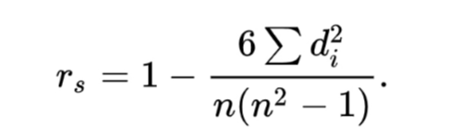
Correlation Analysis - TBD
Spearman Rank Correlation –

Slide 14
Correlation between Metric 1&2 and Metric 3
Project | Sets of data(Package level) | R of metric 1&3 | R of metric 2&3
Apache Common Collection | 19 | 0.3904 | 0.4381
Apache Common Configurations | 17 | 0.9389 | 0.8659
Apache Commons Codec | 7 | 0.98 | 0.9804
Calculate R among the 3 project(43 sets of data) :
Correlation coefficient (Spearman): 0.7201

Slide 15
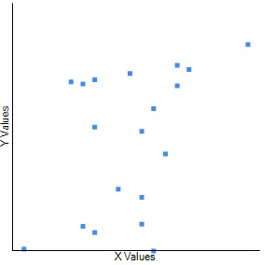
Correlation between Metric 1 and Metric 3 Project: Apache Commons Collections X: Statement coverage Y: Mutation Coverage

Slide 16
Correlation between Metric 1&2 and Metric 3
Hypothesis –
The rationale is that test suits that has higher branch coverage and statement coverage might show better test suite effectiveness.
Conclusion –
The correlation between metric 1&2 and 3 is positive and very strong
We can conclude that suites with higher Statement or Branch coverage showed up with high mutation score.
Therefore, this conclusion is consistent with the rationale that test suites with higher coverage can show better test suite effectiveness.

Slide 17
Correlation between Metric 1&2 and Metric 4
Project | Sets of data(class level) | rs of metric 1&4
Apache commons codec | 119 | -0.2498
Apache commons collections | 474 | -0.3780
Apache commons configuration | 152 | -0.44865
Apache Commons Math
Calculate r_{s} among the 4 projects(1663 sets of data) : = -0.3556
Project | Sets of data(class level) | r_{s} of metric 2&4
Apache commons codec | 82 | -0.3412
Apache commons collections | 319 | -0.2614
Apache commons configuration | 104 | -0.30902
Apache Commons Math
Calculate rs among the 4 projects(1174 sets of data) : rs = -0.2705

Slide 18
Correlation between Metric 1&2 and Metric 4
Hypothesis –
The rationale is that classes with higher complexity are less likely to have high coverage test suites.
Conclusion-
The correlation between metric 1&2 and 4 is negative and the strength of the association is good but not very strong.
We can conclude that classes with higher Cyclomatic Complexity showed up with lower Statement/Branch coverage .
This conclusion is consistent with the rationale that classes with higher complexity are less likely to have high coverage test suites

Slide 19
Correlation between Metric 1&2 and Metric 6
Project | Project Versions | Total Statement Coverage in % | Total Branch Coverage in % | BMI
Apache Common Configurations | 2.1.1 | 93.56 | 84.01 | 90.625
 | 2.2 | 93.48 | 83.96 | 83.06
 | 2.3 | 93.52 | 84 | 160.48
 | 2.4 | 93.53 | 84.08 | 90.48
 | 2.5 | 93.51 | 84.06 | 0
Apache Common Collection | 4 | 88 | 76 | 59.93
 | 4.1 | 88 | 76 | 40.56
 | 4.2 | 89 | 78 | 72
 | 4.3 | 89 | 78 | 70
Apache Common Codec | 1.8 | 98 | 92 | 18.52
 | 1.9 | 98 | 92 | 46.67
 | 1.10 | 98 | 91 | 39.27
 | 1.11 | 97 | 88 | 6.67
 | 1.12 | 97 | 88 | 68.75
Correlation between metric 1 and 6 - Rs = -0.2525
Correlation between metric 2 and 6 - Rs = -0.36424

Slide 20
Correlation between Metric 1&2 and Metric 6
Hypothesis –
The rationale is that if the program has high branch coverage and statement coverage (more of its source code executed during testing) then it has a lower chance of containing undetected software bugs. That means higher test coverage helps to increase software quality.
Conclusion -
Metric1&2 and metrics 6 have a negative and small correlation
If the branch coverage and statement coverage increases, then BMI will decrease slightly.
This conclusion is consistent with the rationale that classes with higher branch and statement coverage, then BMI will decrease.

Slide 21
Correlation between Metric 5 and Metric 6
Project | Project Versions | Maintainability Index | BMI
Apache Common Configurations | 2.1.1 | 65.13 | 90.625
 | 2.2 | 65.14 | 83.06
 | 2.3 | 65.12 | 160.48
 | 2.4 | 64.74 | 90.48
 | 2.5 | 64.74 | 0
Apache Common Collection | 4 | 69.16 | 59.93
 | 4.1 | 69.12 | 40.56
 | 4.2 | 68.84 | 72
 | 4.3 | 68.83 | 70
Apache Common Codec | 1.8 | 65.3 | 18.52
 | 1.9 | 65.27 | 46.67
 | 1.10 | 65.26 | 39.27
 | 1.11 | 65.72 | 6.67
 | 1.12 | 65.79 | 68.75
Correlation between metric 5 and 6 : Rs = -0.21562

Slide 22
Correlation between Metric 5 and Metric 6
Hypothesis –
If the software project has higher MI then the BMI will be less. If the software is more maintainable then it will have less bugs.
Conclusion –
Metric 5 and metrics 6 have a negative and small correlation
If MI increases, then BMI will decreases.
This conclusion is consistent with the rationale that if MI increases then BMI decreases.

Slide 23
Thank you

